Slide 1
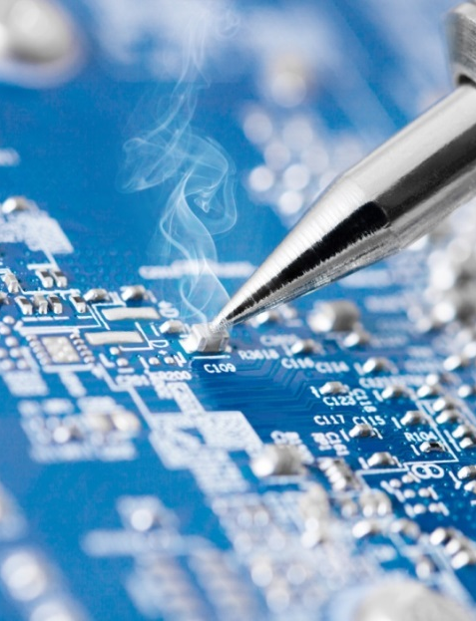
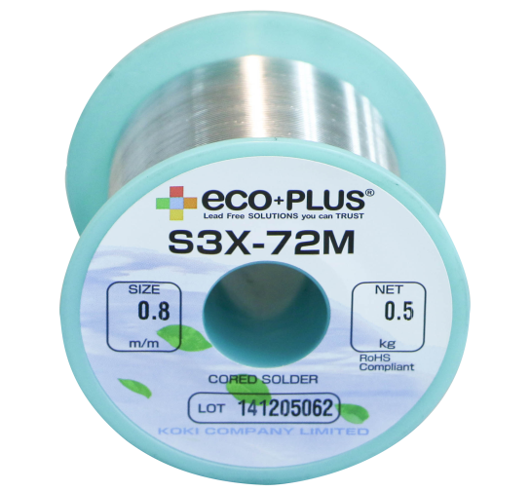
Koki no-clean LEAD FREE flux cored wire solder
72M Series
REACH Compliant
LINE-UP
S3X
S01X7Ca
S03X7Ca
SB6N
- 72M
- 72M
- 72M
- 72M
未溶融
Significantly improved wettability results in wider process range
Improved wettability without compromising flux sputtering
Improved wettability to various metals (brass, nickel, etc…)
Helps preventing defects (bridging and insufficient solder feeding), owing to improved surface covering property of flux
Reduced soldering fume for manual soldering

Slide 2
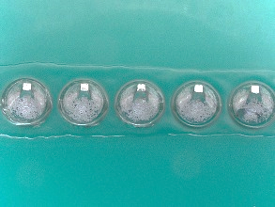
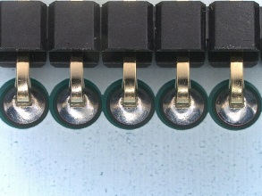
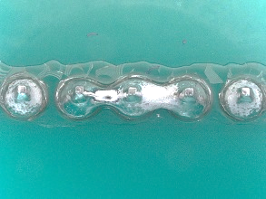
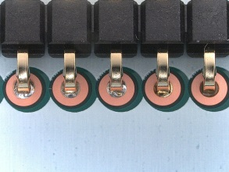
Flux Cored Wire Solder 72M series
■ Powerful wetting & High reliability S3X-72M (Sn 3.0Ag 0.5Cu)
Need for Soldering robot.
FAST wettiing → FAST “slide” soldering
Solution
・ Employment of a new activator system that has FAST-acting nature
・ Koki patented technology
Required performance
・ Fast removal of oxide film
・ Resistant to heat from solder iron
・ High reliability
Wetting
High speed slide soldering
Good
Activator C:
 | Bottom | Top
S3X-72M
従来品
Activator B:
Slow acting
Bridge
Durability
Activator A:
Short durability

Slide 3
Flux Cored Wire Solder 72M series
>SIR in HAST
(HAST: 110C^{O}, 85%RH, DC50V applied in IPC-B-24 board)
(Highly Accelerated temperature and humidity Stress Test) by IEC 68-2-66
No electromigration
Dendrite growth
Occurrence of EM
Excessive volume of activation agent → Deterioration of electrical (SIR/EM) and chemical (corrosion) reliability.
Flux residue from 72M series ensures high reliability even under HAST environment as shown above.

Slide 4
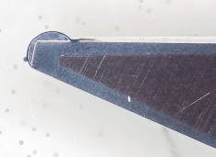
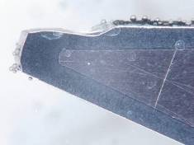
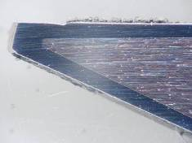
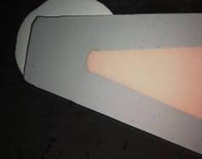
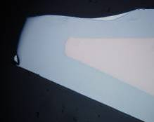
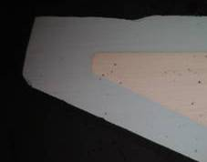
Flux Cored Wire Solder Low Ag 72M series
■ Anti-erosion technology S03X7Ca-72M (Sn 0.3Ag 0.7Cu 0.03Co + α)
>4 times longer Iron bit life!
初期 | S3X (SAC305) | S03X7Ca
Iron layer
Iron tip
Cross-section
未溶融
Fe
Cu
50.5%
16.8%
After 10000 shots
>EMPA analysis of boundaries between solder and iron tip
Schematic view of reaction between
iron tip and melted solder
S3X
(Sn 3.0Ag 0.5Cu)
S03X7Ca
(Sn 0.1Ag 0.7Cu 0.03Co + α)
Melted
SAC305
Melted
S03X7Ca
with Co
Barrier layer
Solder
Solder
Solder
Sn-Fe
Sn-Co-Fe / Sn-Co
通常の反応層
Iron tip (Fe)
Iron tip (Fe)
Iron tip (Fe)
Fe diffusion
Fe diffusion less

Slide 5
Flux Cored Wire Solder Low Ag 72M series
■ Joint reliability after repairing
> Solder joint reliability in re-soldering by S03X7Ca
Iron slide direction
Expected combination of SAC305 : S03X7Ca-72M are;
(1) SAC305 = 100
(2) SAC305 : S03X7Ca = 75 : 25
(3) SAC305 : S03X7Ca = 50 : 50
(4) SAC305 : S03X7Ca = 25 : 75
(5) S03X7Ca = 100
T/C condition: -40/125^{O}C x 1000cyc
Repair SAC305 joint with
S03X7Ca-72M
Mixture of alloys
QFP (0.65P)
Measure joint strength
> 45 deg. Lead Pull test
Result:
Mixture of S03X7Ca in each rate (0~75%) show similar strength.
No deterioration in joint strength even after the T/C occurred.
The results suggest that S03X7Ca ensures equivalent joint reliability as high as SAC305.
Solder joint
Pull
QFP
QFP
T/C: -40/125^{O}C
45deg.

